Slide 1
Companies and locations
Yi-Ru Cheng
Oliver Frendo
Dandan Li
Zehui Wang
Notes:
Hi and good morning
I’d like to welcome you to the presentation of our project results
It was about integrating financial data about companies with data about locations

Slide 2
Agenda
1
Use Case
Data Collection
3
Identity Resolution
4
5
Conclusion
Data Fusion
2

Slide 3
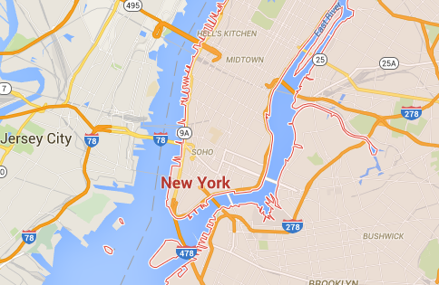
Use Case
Data Science perspective
Company perspective
Analyze relationships between attributes of companies and locations
Distributions of companies over locations
Analyze data in regard to own position vs positions of other companies
Company
Size
Revenue
Location
Language
Population
Notes:
Basically we considered the integrated dataset from two different perspectives
So for example, it would be interesting to know, whether big companies gravitate towards big cities, or whether they have their own „company town“: for example SAP with Walldorf comes to mind
On the other side we can try and use the dataset from a company perspective
So this is just a mockup, but it could look like this

Slide 4


Data Collection (1)
Entities: 2,000
Attributes (7): name, countries, industries, revenue, …
SPARQL query
Forbes (companies)
SELECT ?company group_concat(distinct str(?industry); separator=“;;”) as ?industries
…
WHERE { company rdf:type dbo:Company
optional(?company dbo:industry ?industry) …
}
Entities: 16,051
Attributes (9): name, countries, industries, numberOfEmployees, dateFounded, …
DBpedia (companies)
Notes:
To begin with: Forbes
I’m sure everyone knows Forbes, publish list of richest people in the world, where you usually get envious, but also list of 2000 biggest companies
This was a good dataset in the sense that it has very dense attributes and probably very reliable data
So not to go into too much detail here because a lot of groups used DBpedia and SPARQL
One thing worth nothing is we had some attributes with multiple values, for example industries
We concatenated these, else we had some problems with MapForce
Also it made a later comparison with for example Jaccard easier

Slide 5

Data Collection (2)
Entities: 2,000
Attributes (7): name, countries, industries, revenue, …
Entities: 3,182
Attributes (9): name, countries, industries, numberOfEmployees, dateFounded, …
Forbes (companies)
MQL query
Freebase (companies)
"name": null,
"name!=": "null",
"/business/employer/number_of_employees": [{
"number": null
}],
"/organization/organization/headquarters": [{
"/location/mailing_address/citytown": null,
"/location/mailing_address/country": null
}],
…
Entities: 16,051
Attributes (9): name, countries, industries, numberOfEmployees, dateFounded, …
Entities: 3,270
Attributes (5): name, population, area, elevation, country
DBpedia (companies)
DBpedia (locations)

Slide 6
Data Collection (3)
Numeric attributes
1.17E+10 → 11,700,000,000
Remove punctation/ stopwords
Apple_,Inc. → Apple
The Coca Cola Company → Coca Cola
Normalize countries
USA, US → United States of America
UK, GB → Great Britain
Normalize names
Remove DBpedia URLs
Notes:
Next some standard stuff for preprocessing during data translation
Countries: So I think a lot of other groups especially for city use cases also did this
For us this was a very important step because it helped with blocking functions: Generated more pairs
Normalize names: Had to remove URLs in order to be able to compare DBpedia with other datasets

Slide 7

Identity Resolution (1)
Forbes (companies)
Freebase (companies)
Gold standard
Training data: 220 cases (100 true, 120 false)
Test data: 27 cases (12 true, 15 false)
Sample corner cases:
“Chevron“ vs “Chevron Corporation“ (true)
“Makita“ (U.S.) vs “Makita“ (Japan) (true)
“East Japan Railway“ vs “West Japan Railway“ (false)
Notes:
So next we’ll come to the topic of identity resolution
So this first one, for example, makes sure that our stopwords removal works properly
The last one actually keeps popping up, it’s really very hard to match properly
…and as you can imagine, they have a lot of very similar attribute values

Slide 8
Identity Resolution (2)
Forbes (companies)
Freebase (companies)
Correspondences
n=509
Matching rules (excerpt)
Name: Levenshtein
Good: “Prudential“ vs “Prudential plc“
Bad: “West Japan Railway“ vs “East Japan Railway“
Industries:
“Computer, Transportation“ vs “Transport, Computers“
Jaccard (0.00) vs Levenshtein (0.00) vs Hybrid (0.75)
Locations:
“New York, London“ vs “New York City“
Jaccard (0.00) vs Highest Jaccard (0.67)
Notes:
Ok so that was the gold standard – next we come to the correspondences
For name we ended up using Levenshtein
For industries we had several different approaches
So if you consider this string for example

Slide 9
Identity Resolution (3)
Forbes (companies)
Freebase (companies)
Correspondences
n=509
Blocking functions
CrossProduct:
509 matches, reduction ratio: 1.00
SortedNeighbourhood (country)
319 matches, reduction ratio: 6.80
Partitioning (country)
425 matches, reduction ratio: 20.19
Notes:
Because the datasets were comparatively small, we were able to use CrossProduct
Used Partitioning when we wanted to test quickly
The difference between CrossProduct and Partitioning shows that there are some missing country values in Freebase, which you will see later as well

Slide 10
Identity Resolution (4)
Forbes (companies)
Freebase (companies)
Correspondences
n=509
Correspondences
n=671
DBpedia (companies)
Notes:
Ok so moving on, the next dataset DBpedia: won’t go into detail on the gold standard here

Slide 11
Identity Resolution (5)
Forbes (companies)
Freebase (companies)
Correspondences
n=509
Correspondences
n=671
Learning matching rules (linear regression)
Important attributes:
name: 0.689 keyPeople: 0.377 locations: 0.218
Unimportant attributes:
revenue: 0.000 numberOfEmployees: 0.000
DBpedia (companies)

Slide 12
Identity Resolution (6)
Forbes (companies)
Freebase (companies)
Correspondences
n=509
Correspondences
n=671
Blocking functions
Partitioning (country)
576 matches, reduction ratio: 15,92
Partitioning (dateFounded)
496 matches, reduction ratio: 9,43
Partitioning (combination)
671 matches, reduction ratio: 6,13
DBpedia (companies)

Slide 13
Identity Resolution (7)
Forbes (companies)
Freebase (companies)
Correspondences
n=509
Correspondences
n=671
Correspondences
n=7,921
DBpedia (companies)
DBpedia (locations)

Slide 14

Data Fusion (1): Gold standard
Datasets
Attribute
name | IBM
industries | Computer hardware, Information technology consulting, Software
revenue | 92,800,000,000
keyPeople | Virginia Rometty
countries | United States of America
Fusion
Fused results
……
Notes:
So for this last gold standard, the one for the fusion, we took external data from as close a source to the company as possible. So for example the yearly revenue was pretty easy to find in a press release
If we couldn’t find this, such as the numberOfEmployees, we looked on other more reliable websites, such as statista.de

Slide 15

Data Fusion (2) : Conflict resolution functions
Attribute name | Datasets in which the attribute is found | Conflict resolution function | Accuracy
industries | Forbes, DBpedia, Freebase | Intersection | 0.88
 |  | Union | 0.94
dateFounded | DBpedia, Freebase | MostComplete (date) | 0.94
 |  | MostComplete (sample) | 0.94
 |  | Combination | 0.94
marketValue | Forbes | SingleSource | 0.94
keyPeople | DBpedia, Freebase | Intersection | 0.93
 |  | Union | 0.94
locationName | DBpedia (companies), DBpedia (locations), Freebase | Intersection + MostComplete | 0.93
 |  | Union+ MostComplete | 0.94
Notes:
Ok so next we’ll come to the actual conflict resolution functions, please note this is just an excerpt
I’ll start with the attribute industries
We ended up implementing these functions ourselves due to the way we stored the industries for example
Moving on to dateFounded: The three functions show seem to make no differences in accuracy. However we decided this approach makes the most sense logically
An interesting thing to point out is the difference between industries and keyPeople here: It seems using intersection with industries is a lot worse than using it for keyPeople
To explain why maximum accuracy is 0.94: There were some attributes in our fusion gold standard which just werent contained in any of the datasets

Slide 16
Data Fusion (3): Attribute densities
Attribute | Forbes (n=2,000) | Freebase (n=3,182) | DBpedia (n=16,051) | Consistencies | Fused (n=6,470)
name | 1.00 | 1.00 | 1.00 | 0.97 | 1.00
countries | 1.00 | 0.40 | 1.00 | 1.00 | 1.00
industries | 0.98 | 0.54 | 0.61 | 0.93 | 0.65
numberOf-Employees | 0.00 | 1.00 | 0.32 | 1.00 | 0.38
locations | 1.00 | 1.00 | 1.00 | 0.90 | 1.00
Notes:
Again just an excerpt
So this table shows the attribute densities
So for example name is 1 for all datasets which is good, because it was non-optional in each query
One point here: Density for countries in Freebase is rather low: This is due to the nature of freebase. I’m sure some of you ran into similar issues with DBpedia as well: It will return a location with a city but no country defined

Slide 17
Conclusion
Data Collection
Flexible data collection from Freebase and DBpedia via queries ➔ Goal: Balance between enough data and sparsity of attributes
Identity Resolution
Low number of correspondences from Freebase to Forbes ➔ Many companies not available in Freebase dataset
High number of correspondences for locations
Data fusion
Implemented fusion functions
Fused entities: 6,470
Outlook
Select metadata from DBpedia and Freebase ➔ (e.g. most recent date modified)
Use as basis for conflict resolution functions
Notes:
So, to conclude:

Slide 18
Thank you!

Slide 19
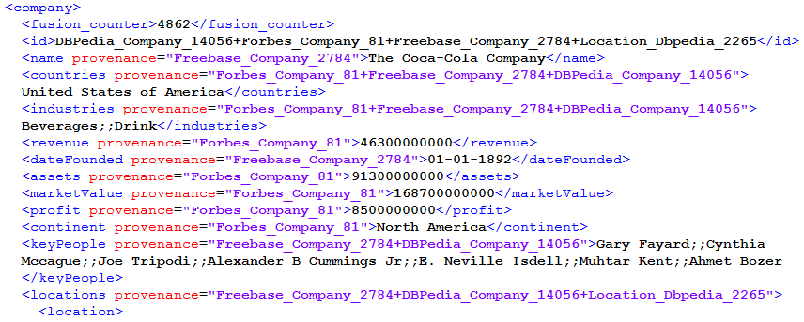
Sample fusion result (excerpt)
Notes:
If showing this: take out provenance information, or take only a couple of attributes

Slide 20
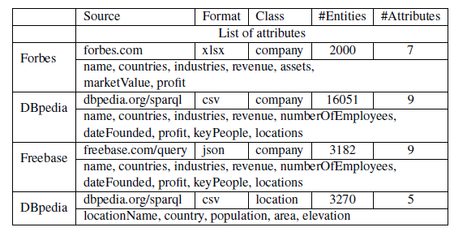
Basic profile of each dataset

Slide 21
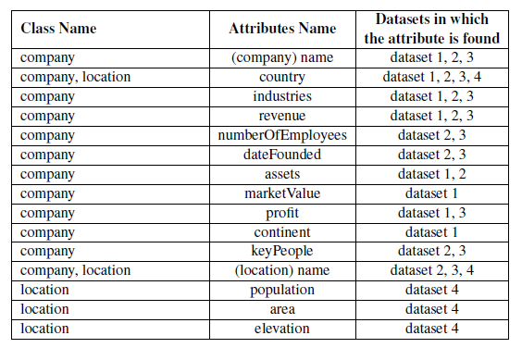
Integrated schema
Datasets:
Forbes → 1
DBpedia (companies) → 2
Freebase → 3
DBpedia (locations) → 4

Slide 22
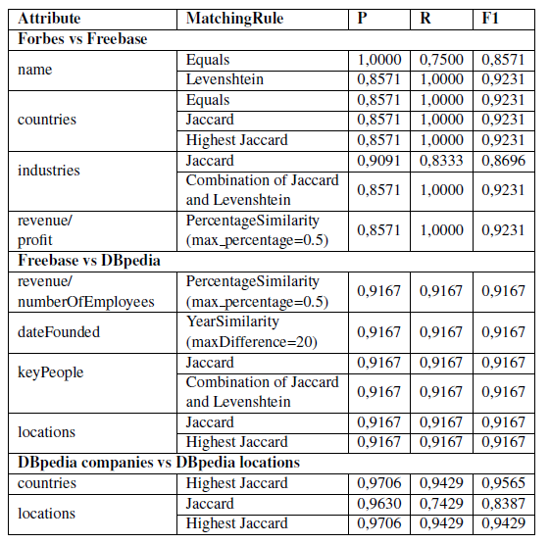
Matching rule accuracies

Slide 23
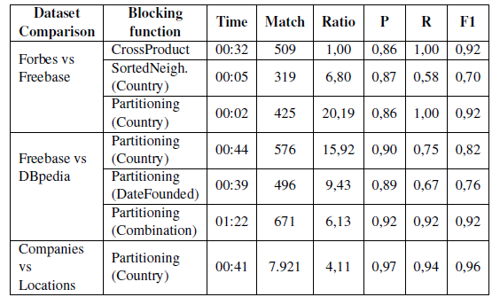
Blocking functions

Slide 24
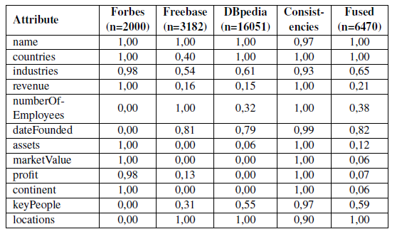
Attribute densities

Slide 25
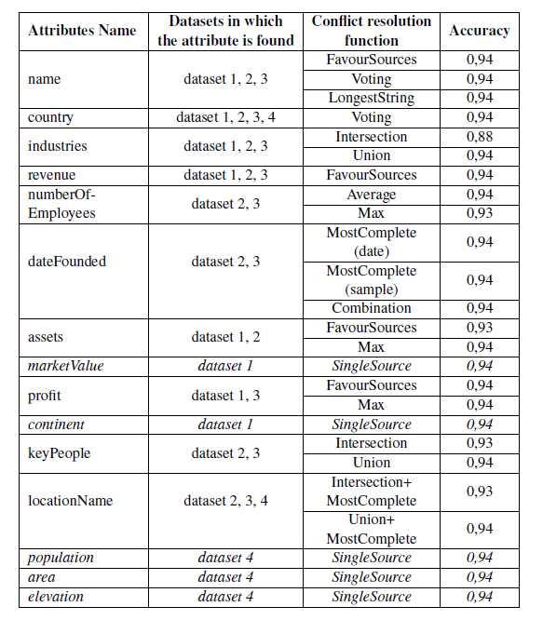
Conflict resolution functions
Datasets:
Forbes → 1
DBpedia (companies) → 2
Freebase → 3
DBpedia (locations) → 4

